Slide 1



SAE NIS EFFI-CYCLE >>>Drive The Future<<<
Power Enhancement Season
Business Plan Presentation
21028_Invincibles 5.0
Conventional
Osmania University
Hyderabad ,Telangana

Slide 2
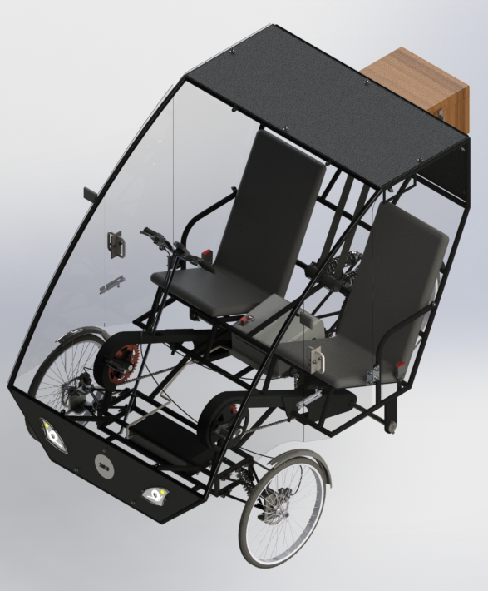
About Us
ONYX
Ride forward, Drive future
About company
We are an automotive company that manufactures a three wheel hybrid electric vehicle known as EFFICYCLE . We are capable of producing 2000 units per year . We're dedicated in offering exceptional customer experiences. We strive to empower people's lives, help to preserve the environment and donate to numerous causes . These are the things that matter to us—the things that drive us every day.
1
Features
Manual and Automatic Transmission
Hybrid Drive
Dual Transmission
Easy to operate
Easily Serviceable
Lighter vehicle
2
3
Branches
HYDERABAD (Main Branch)
Mumbai
Bangalore
Visit Us : www.onyxmotors.com

Slide 3
Organization Chart
CEO
GM Marketing
GM Operations
Sales
GM Administration
Finance
HR
Quality
Design and development
Production
Supervisor
Engineers
Inspectors
Advertising
Creative Head
Web Developers
Ads and Social Media
Accountant
Cashier
Salesman
Labour
Customer Service
Salesman

Slide 4
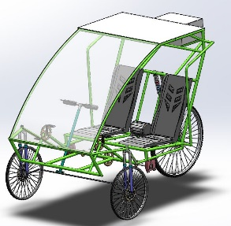
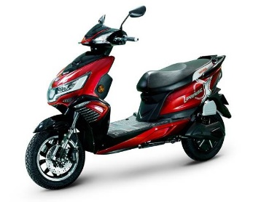
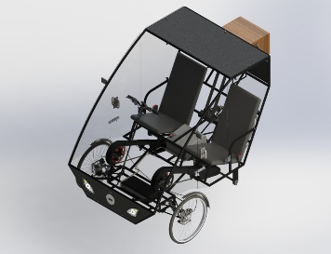
Market analysis
Parameter | Other conventional Efficycle | Electric scooters or bikes | Our Efficycle
Range of Travel | 80 miles | 40-50 miles | 85 miles
Cost on Average | ₹ 90,000 - ₹1,00,000 | ₹ 70,000 - ₹1,00,000 | ₹ 80,000
Who can Drive it | People from all age groups and also physically challenged people with others help | Handicapped cannot drive because of imbalance | People from all age groups and also physically challenged people with others help
Service and Strength | Easily Serviceable and Comparatively Low strength | Difficult to service and Can Withstand Simple damages | Easily Serviceable and Comparatively Stronger
Pay Load | Can bear payload of 10 kgs | Can bear a payload of 30 kgs | Can bear a payload of 50 kgs
Battery Warranty | 2-3 yrs | 2-3 yrs | 2-3 yrs
Charging time | 8 – 9 hrs | 2-3 hrs | 7-8 hrs
Other Features | Dual Mode of Transmission | GPS and Some other features | Both manual and automatic gear shifting . Dual Mode of Transmission . Full Enclosure and compatible in rain .
Photos

Slide 5
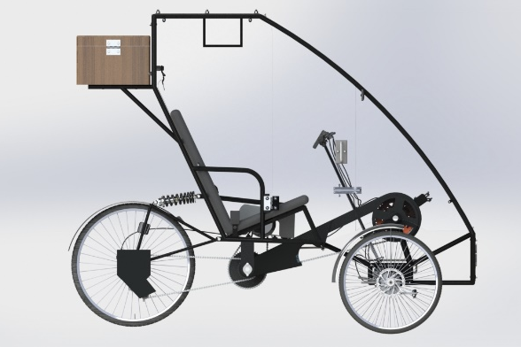
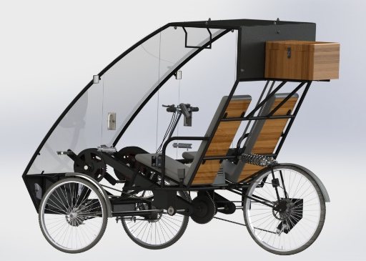

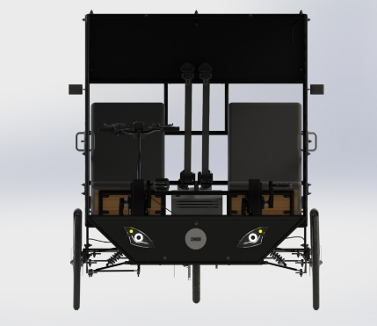
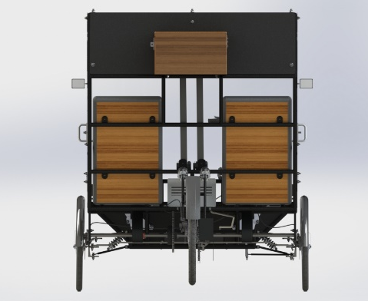
VECHILE VIEWS
③ SIDE VIEW
② REAR ISOMETRIC VIEW
① ISOMETRIC VIEW
④ FRONT VIEW
⑤REAR VIEW

Slide 6
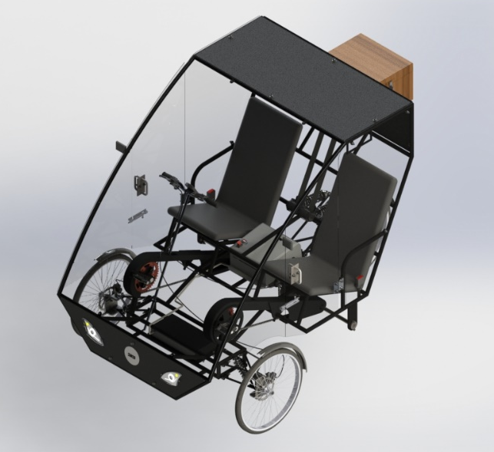
FEATURES OF VEHICLE
WEIGHT AND DIMENSIONS:
Kerb weight = 118 KG
Length = 86.2”
Height = 67“
Width = 58“
Track Width = 55”
Wheel Base = 54.5”
MATERIAL SPECIFICATION:
AISI 4130 for Roll Cage
Aluminium 6061-T6 for Rear Suspension, Handle bar, Steering column
Aluminium 1060 for chain guard
AISI 1018 for A-Arms and Knuckle
POWER TRAIN:
Automatic gear shifting
Shaft Diameter = 20mm
Shaft Material = EN19
11-32 9 Speed Cassette
BRAKING:
Mechanical Disc Brake
Rotor Diameter : 160 mm
WHEELS:
Spokes
Front Wheel Diameter : 20”
Rear Wheel Diameter :26”
SUSPENSION:
Front suspension : Double Wishbone
Spring Travel : 36 mm
Spring Length : 7.97”
Rear suspension : Coil Over
Spring Travel : 36 mm
Spring Length : 10.15”
STEERING:
Linkage Setup
Steering Ratio : 0.926 : 1

Slide 7
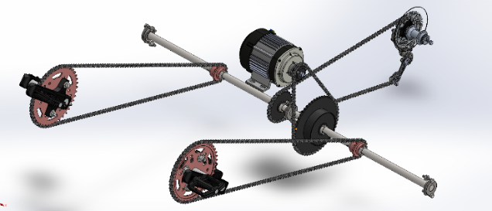

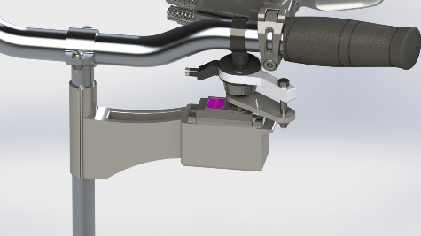
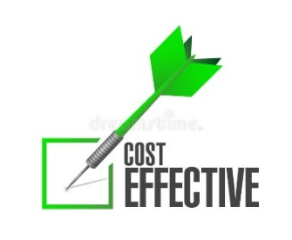


Unique Selling Proposition (USP)
Promotes Fitness
Dual mode of transmission
Simple and Easy to handle
Smart Gear Shifting
good quality at low cost
Easily Serviceable
GST reduction on Electric Vehicles
Eco Friendly

Slide 8

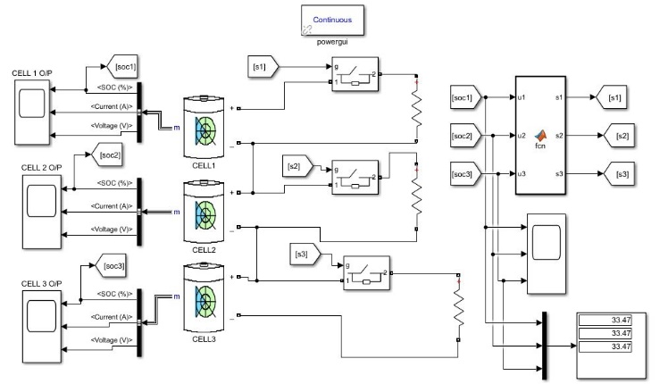
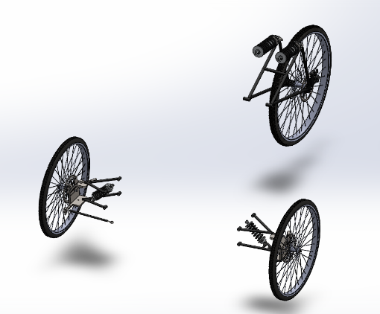
Different concepts and variants
Dual mode of transmission
Smart Gear Shifting
Regenerative Braking
Full enclosure of the vehicle
Hybrid light Electric Vehicle, high durable and energy efficient
Double Wishbone

Slide 9
Cost of Product In Mass Production
Total amount to fabricate single vehicle = 1,25,000/-
Cost of one vehicle when manufactured in bulk = 62,500/-
Fixed cost = 20,00,00,000/-
Total variable cost per year = 3,60,000/-
Cost of 2000 units = 26,00,00,000
Other expenses = 80,00,000/-
Net business expenses per year = 26,80,00,000/-
Fund Raising Strategies
Funds Through Angel Investors
Becoming a Public limited company
Through Venture Capitals
Loans
Using Few Government Schemes like MUDRA, Where when approved can get funds
Incubator accelerator
Crowd Funding
Personal Funding

Slide 10
Plant Layout for Mass Production
Storage
Transport
Welding
SUPPLIERS
Foundry
CUSTOMERS
Quantity check
Cutting
Drilling
Finishing
Godown
Assemblies
Inspection
INVESTMENT
Land – 0.5cr
Construction – 0.5cr
Machinery and tools – 1cr
Other Costs(Shipping) – 1cr
Initial Investment – 10cr
Total Investment for layout - 13cr
Secondary Store Rooms and Online Inspection
Machinery
Universal Testing Machine
Hardness Testing Machine
Lathe Machine
CNC Machine
TIG Welding Equipment
Foundry Equipment
Functional layouts
Assembly line

Slide 11
BREAK EVEN ANALYSIS
SELLING PRICE = 80,000 /-
For Reaching Break Even Point,
2400 units are to be sold.
The ideal time for selling 2400 units is
438 days.
(i.e. 2400*80000=19,20,00,000 )
Profit
Break Even Time: 438 days
Break Even Units : 2400
Assumed Real Break Even Time: 500 days

Slide 12
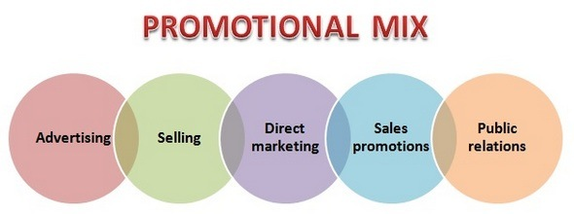




PROMOTIONAL STRATEGIES
Promoting the vehicle using proper promotional mix
Using Efficycle as a rental vehicle
Providing free test drives
Advertising the vehicle targeting specific audience
Providing special discounts for students
0
Promoting Vehicles in campaigns like GO-GREEN Campaign
Providing free service for the first time

Slide 13






AFTER MARKET STRATEGIES
Providing Seasonal Discounts
Create a loyal base for customers and maintain brand value
Powerful Field Service management
Priority to customer complaints
Customising Vehicle According to customer requirement
Full fill promises made on design, Price, Discount, Delivery
Increase responsiveness and efficiency
Warranty and service contacts

Slide 14
SWOT ANALYSIS
STRENGTH
Eco Friendly
WEAKNESS
Lower Speed
THREATS
Expensive Raw materials
OPPORTUNITIES
Rising Fuel costs
Less Sound
Dual Mode of Transmission
Lower Tax
Lower Load bearing Capacity
Consumer Friendly
Charging Time
Replacement of battery is Expensive
Demand for eco-friendly vehicles
Government subsidy for Electric vehicles
Rise in electricity costs
Low market acceptance
Recent financial crisis
High initial investment
App based Services like UBER,OLA can create new market
Suitable for all age groups

